Slide 1
Data flow diagram

Slide 2
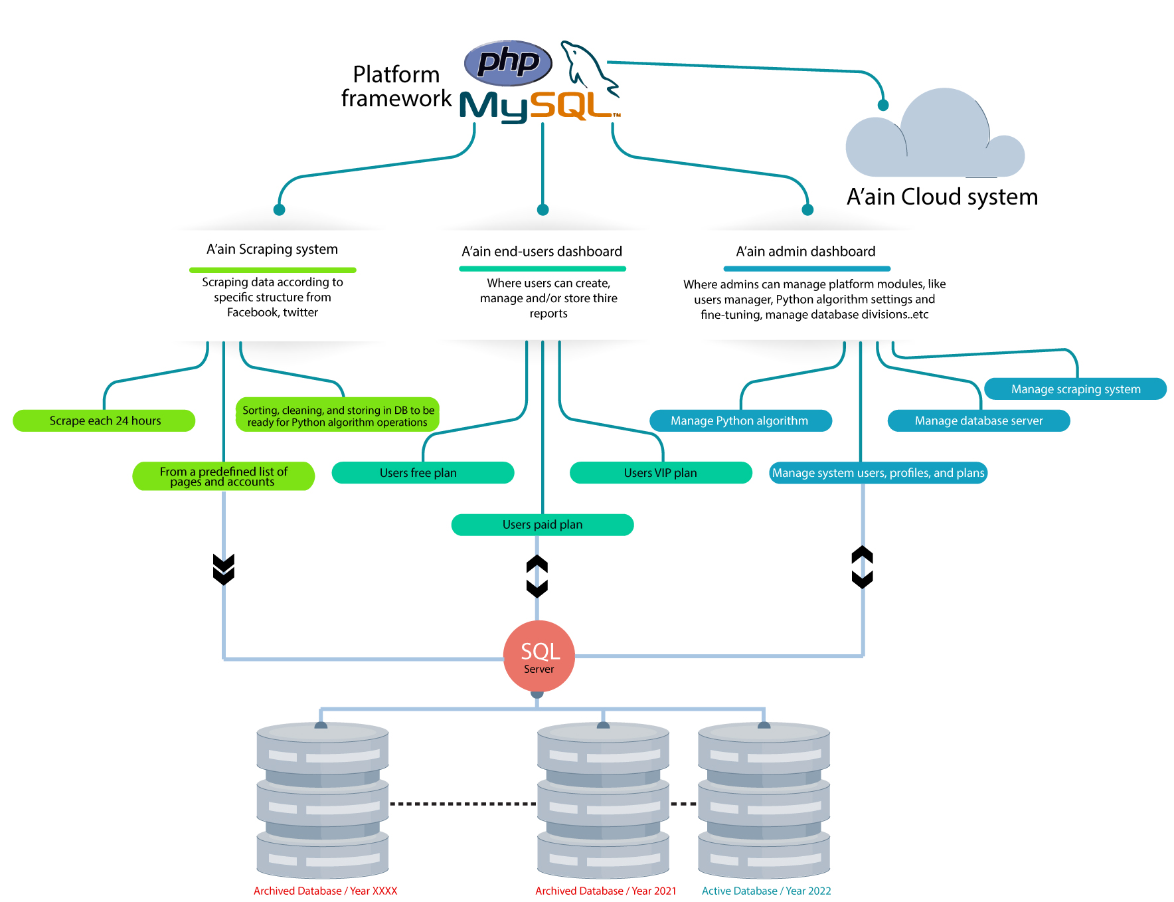

Slide 3
User flow diagram

Slide 4
